Slide 1
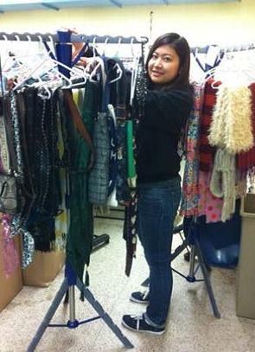

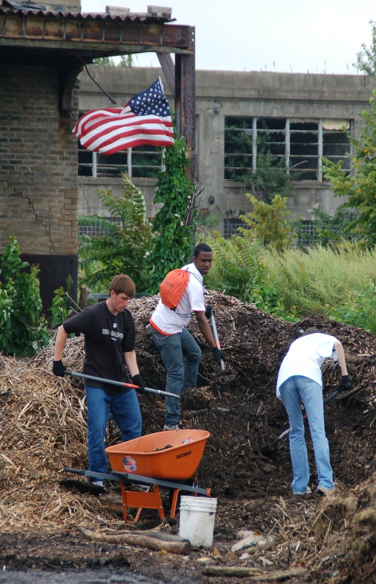
South Wing 120
716-878-3919
cce@buffalostate.edu
http://cce.buffalostate.edu

Slide 2
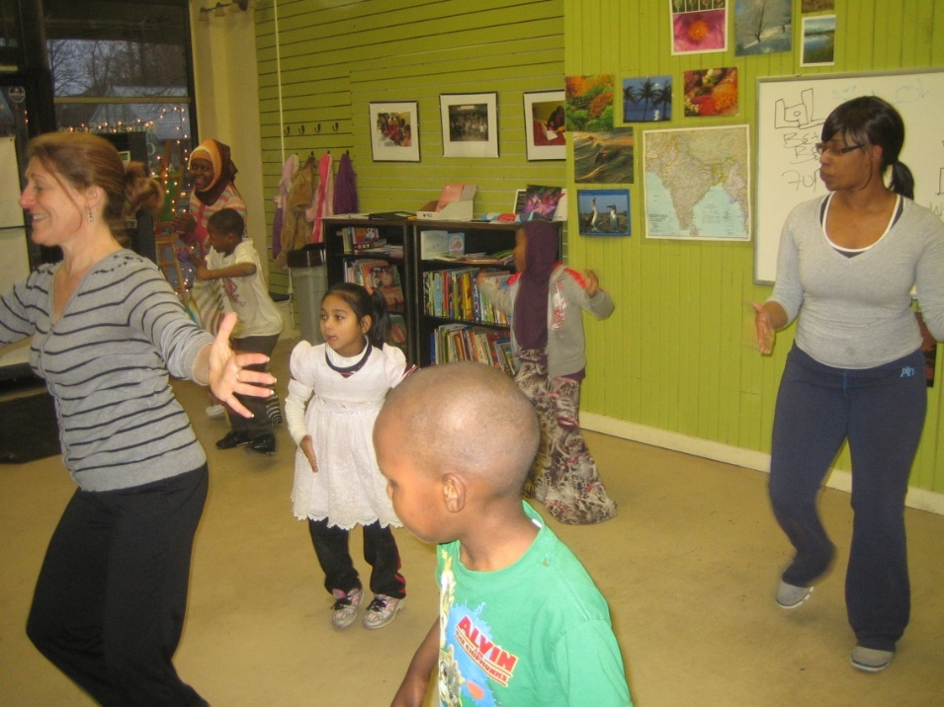
WHAT IS SERVICE-LEARNING?
A form of active learning that links learning in the classroom with activities that students participate in to address community-identified priorities.
In 2019-2020, 1,528 students completed 36,545 hours of service through 137 service-learning courses.

Slide 3
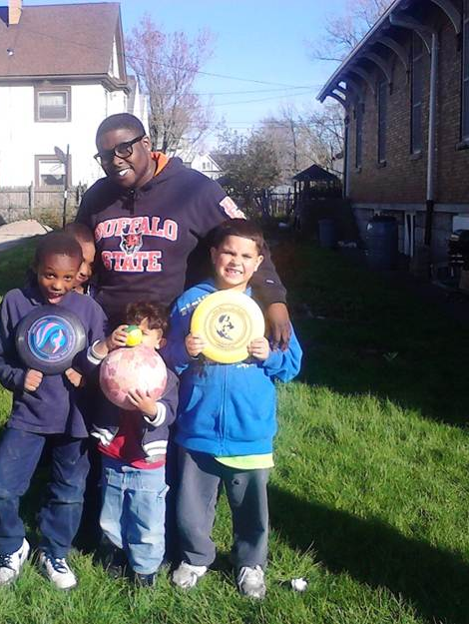
BENEFITS OF
SERVICE-LEARNING
FOR STUDENTS
Develop and improve skills
Meet new people
Improve your resume
Explore professional fields
Be an active citizen!

Slide 4
Notice Anything?
TEN TOP SKILLS EMPLOYERS WANT
National Association of Colleges and Employers
Ability to work in a team
Problem-solving skills
Plan, organize and prioritize work
Verbal communication skills
Research skills
Analytical skills
Technical skills
Computer skills
Written communication skills
Leadership
BUFFALO STATE STUDENT-REPORTED BENEFITS OF SERVICE-LEARNING
* Working as part of a team
*Communication skills
* Problem-solving skills
* Research skills
* Analytical skills
* Critical thinking skills
* Computer skills
* Social self-confidence
* Public speaking skills
* Real world experience

Slide 5
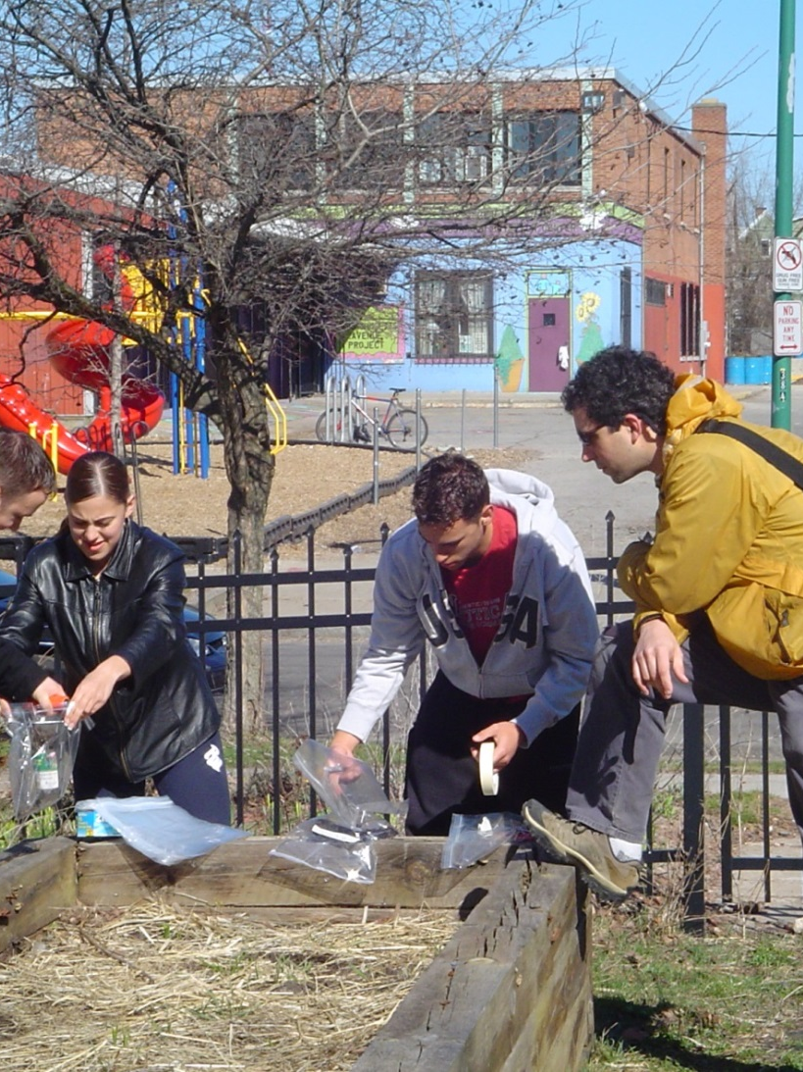
REFLECTIONS FROM OTHER STUDENTS
After service-learning participation
86% encourage other students to try service-learning;
96% believe they can make a difference in the community;
96% feel they have learned from people who have different backgrounds.

Slide 6

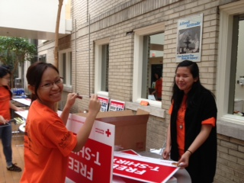
THE IMPACT OF YOUR SERVICE-LEARNING
EXPERIENCE ON THE COMMUNITY
Community partner organizations state that mutually-beneficial partnerships with service-learning students help them…
100% incorporate new ideas;
100% increase the number of clients served;
98% better meet community priorities;
96% increase mentoring services;
98% increase services offered;
98% make new connections.

Slide 7

BUFFALO’S ASSETS
Buildings designed by over 100 American architects, including H.H. Richardson, Louis Sullivan, E.B. Green, and Frank Lloyd Wright
Buffalo Parks System designed by Fredrick Law Olmsted
21 institutions of higher education in the metro-region
2,000 refugees and immigrants resettle in Buffalo every year
Locally-owned businesses and business associations
This Photo by Unknown Author is licensed under CC BY-NC-ND
Notes:
H.H. Richardson- designed the former Buffalo State Hospital (now Buffalo Psychiatric Center) across from campus.
Louis Sullivan- designed the Guaranty Building downtown
E.B. Green- designed the Marcy Casino in Delaware Park & ten grand homes on Delaware Ave
Frank Lloyd Wright- designed Graycliff, Darwin Martin House, and Larkin Company Administration Building
The Park System included parks (such as Delaware Park) and parkways (Lincoln Parkway, etc.). Fredrick Law Olmsted also designed Central Park in New York City, as well as parks in Paris, France and Washington D.C.

Slide 8
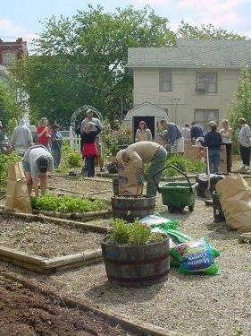
BUFFALO’S ASSETS
There are miles of waterfront on Lake Erie and the Niagara River
Garden Walk Buffalo, with more than 80 community gardens featured, is the largest garden tour in America
Buffalo is home to over 50 art galleries and 22 professional theaters
Shakespeare in Delaware Park is the 2nd largest outdoor Shakespeare festival in the country
The city hosts the third oldest zoo in the U.S.
This Photo by Unknown Author is licensed under CC BY-NC-ND
Notes:
Community gardens are overseen by Grassroots Gardens of Buffalo, a non-profit, that helps block clubs and residents secure and lease vacant land from the city where they plan to place the garden
Garden Walk Buffalo was established in 1995 and over 60,000 people visit the gardens each year.

Slide 9
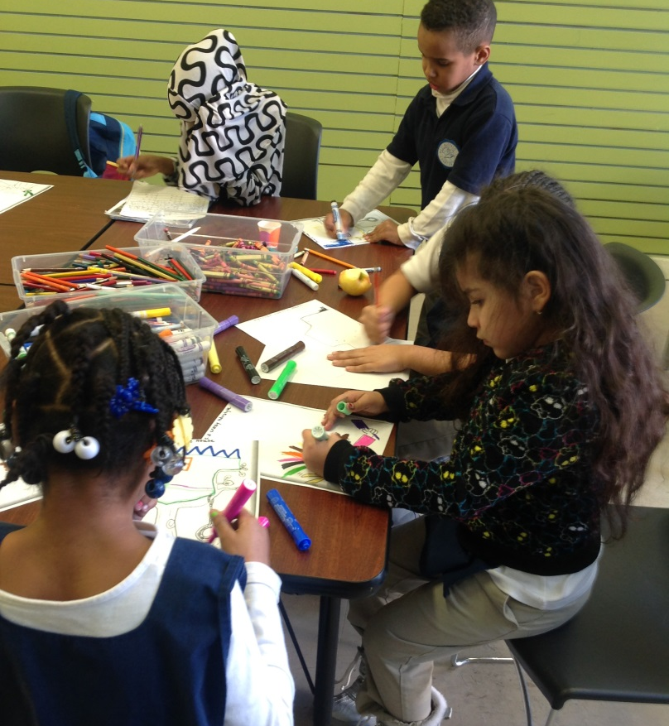
NEW ARRIVALS ON THE WEST SIDE
24% of all refugees who come into NYS settle in Buffalo
Each year 1,600-2,000 refugees are resettled in Buffalo
The West Side is the most diverse neighborhood, where over 70 languages are spoken
Countries of origin include Afghanistan, Bangladesh, Bhutan, Ghana, Iraq, Myanmar, Nepal, Pakistan, Somalia, Sudan, and Thailand
Notes:
The Westside is attractive due to abundant, low-cost housing, and easy access to public transportation

Slide 10
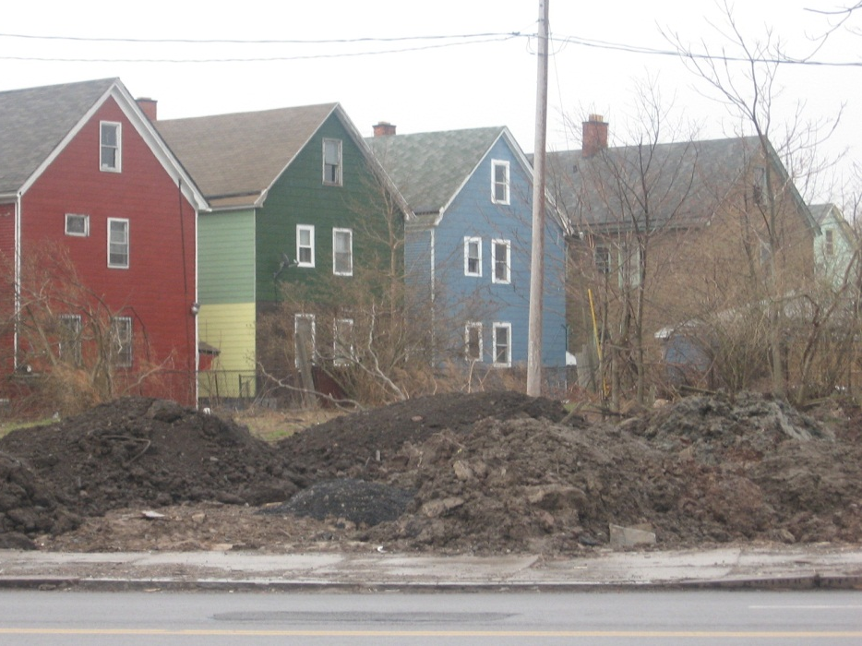
BUFFALO’S CHALLENGES
Buffalo is the 4th poorest large city in the U.S.
33% of its families live in poverty
16.3% of buildings and 7000 lots are vacant
More than half of Buffalo households (55%) cannot afford their gross rent (rent plus utilities)
Gentrification is occurring in many neighborhoods, raising rents and increasing poverty
Notes:
Information taken from Partnership for the Public Good

Slide 11
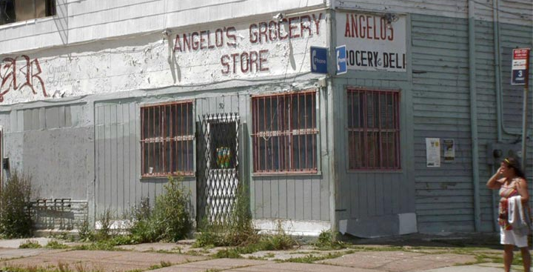

BUFFALO’S CHALLENGES
Over 5,000 people are homeless on any given night in Erie County
Only 42% of the region’s jobs are accessible by public transit within a 90-minute commute
One third of the work force earns a median income below $26,000/year
The Buffalo-Niagara region is the 6th most economically and racially segregated region in the U.S.
Notes:
The homeless number refers to individuals who are staying in shelters and on the street
Data taken from: Homeless Alliance of WNY; Partnership for the Public Good

Slide 12
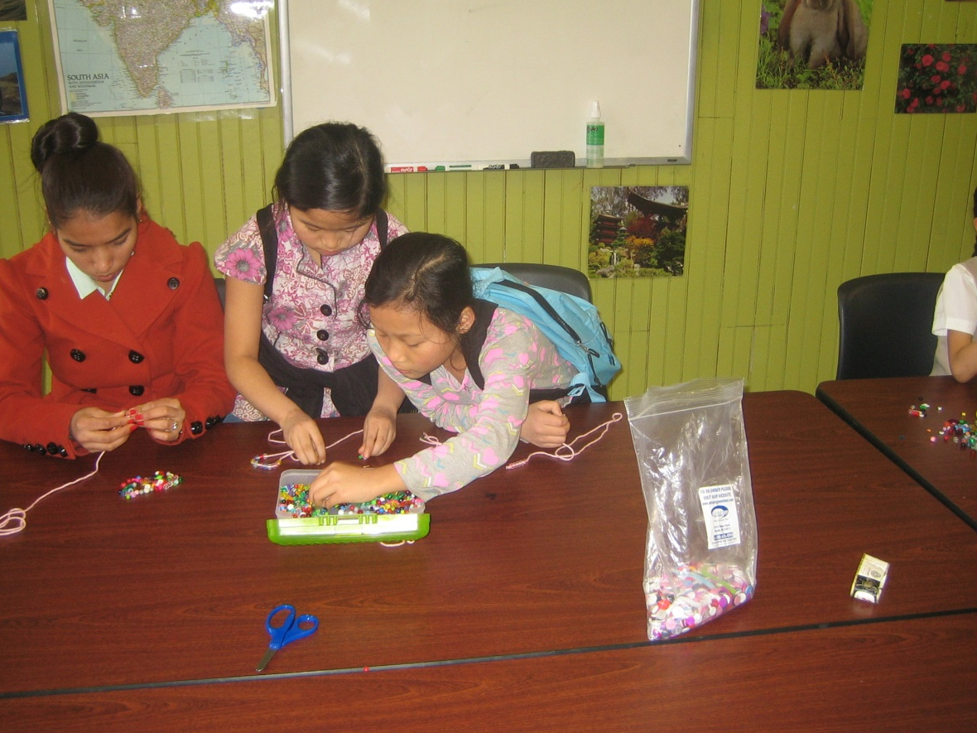
BUFFALO’S YOUTH
4 out of 5 students in Buffalo Public Schools are economically disadvantaged
The high school graduation rate for the city is 64%
Notes:
Without a high school diploma, a young person is twice as likely to be unemployed

Slide 13
Communication students create a PR campaign to inform the neighborhood about activities in a community garden that used to be a vacant lot
Dance and theater students provide arts instruction for youth who do not have access to programming
Nutrition students provide health education
Social work students provide assistance to organizations that serve the homeless
Education students engage in extensive classroom support, tutoring, and educational activities
Ways in which Service-Learning students aid in addressing solutions to Buffalo’s challenges

Slide 14
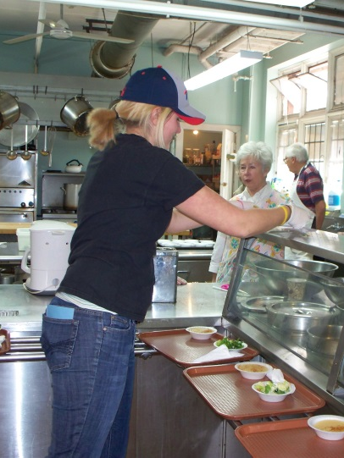
Communicating
with your
Community Partner
When calling your contact or arriving at the site for the first time:
introduce yourself;
identify the reason you are calling (or are present);
identify the service-learning course and professor;
indicate how many hours you are required to complete for the course;
know the course’s objective for your service-learning.

Slide 15
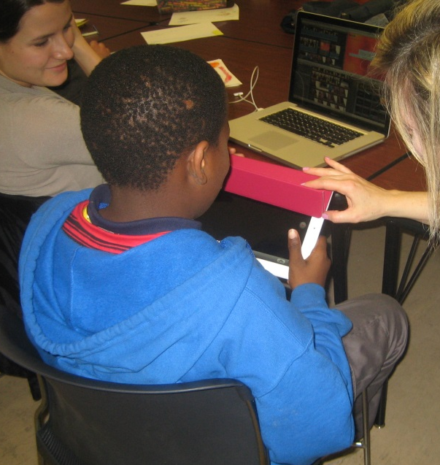
EXPECTATIONS
Be prompt and positive at the organization
Be open to learning about cultures and lifestyles that are different from your own
Be respectful
Follow procedures of the organization
Communicate with your supervisor if you are unable to make your scheduled time
Address issues promptly (with supervisor, faculty, CCE staff)
Dress professionally and/or appropriately

Slide 16

TRANSPORTATION
Public Transportation (www.NFTA.com)
Carpool
Personal Transportation
For assistance with directions, please ask for assistance from your faculty, community partner organization, or the CCE

Slide 17
SAFETY REMINDERS
Familiarize yourself with the new area ahead of time
Travel with a buddy, whenever possible
Carry only what you need
Tell someone where you’re going and when you expect to return
Always lock your vehicle doors. Never leave valuables in plain sight
Sign in following organization’s procedures
Park or walk in well-lit areas
If you become a victim of a crime, call 911 (on-campus, call 716-878-6333)
Notes:
It’s important to always keep in mind safety while on campus, at home, or in the community.

Slide 18
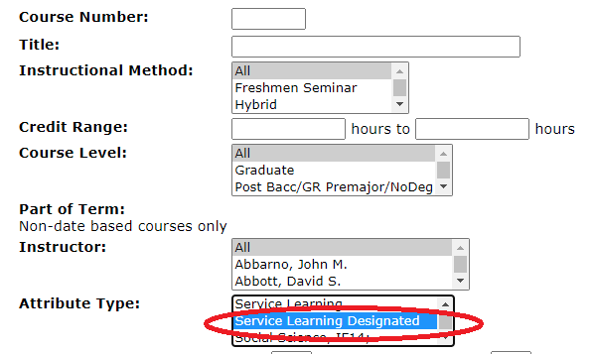
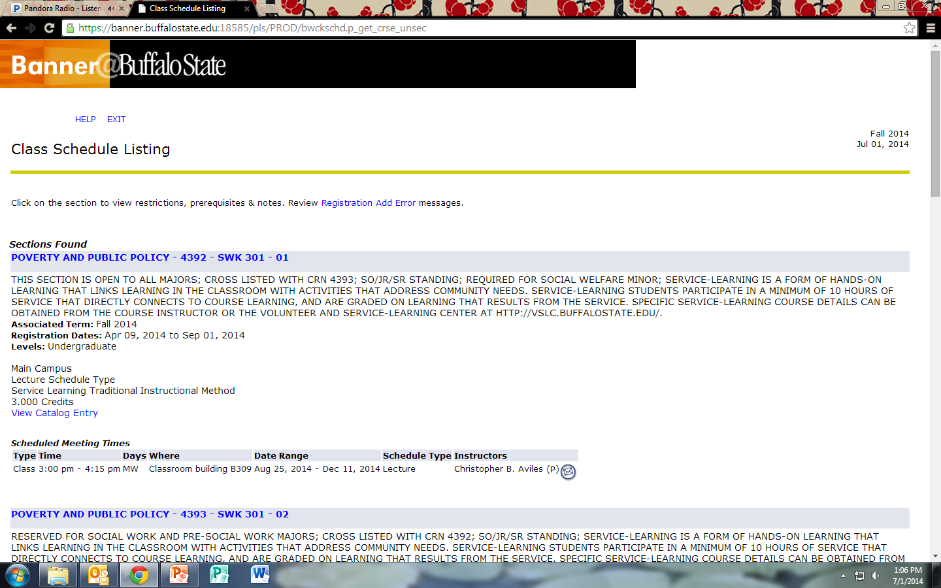
Do You Like Service-Learning?
To Find Service-Learning Designated Courses:
To Know if a Course includes Service-Learning:
Notes:
Designated Service-Learning courses can be found in Banner.
To find a service-learning designated course when scheduling courses for the next semester, choose one of the three choices under the “attribute type” tab.
To know if a course includes service-learning, click on and read the description of the course.

Slide 19
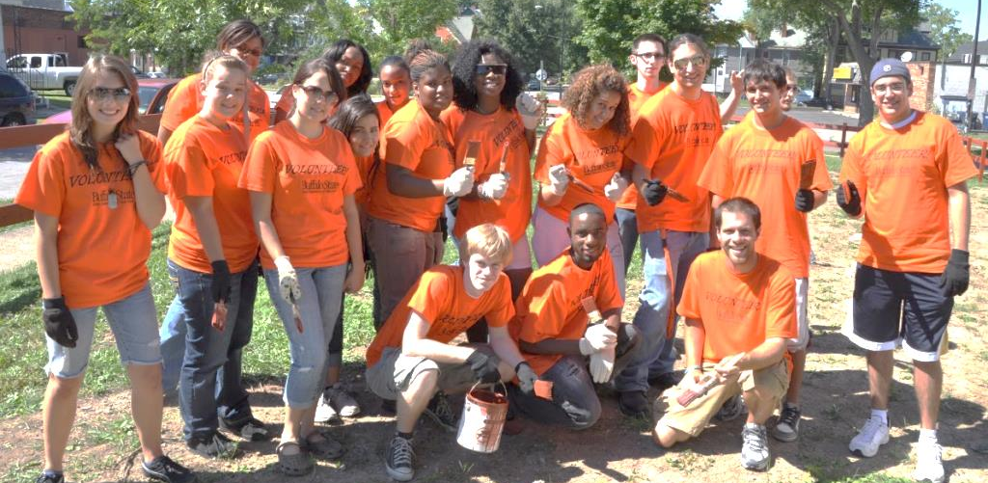

OTHER CIVIC AND COMMUNITY ENGAGEMENT OPPORTUNITIES
Bengals Dare to Care Day | Student Civic Leadership Board
Global Youth Leaders | WSPN Leadership Program
Register and Turn out to VOTE! | Service-Learning Courses
@buffalostatecce
Notes:
There are other ways to get involved with CCE programming both on and off campus!

